Slide 1
Cerner Code Learning Lab CHC 2020
SMART on FHIR Authorization
Hank DeDona
Cloud Identity and Access Management
Notes:
SECTION SLIDE: Right-click image to replace.
**Slide not built in master slides due to the ability to swap out images.

Slide 2
Introduction
This is an overview of Cerner’s authorization guide to help you get started. The full authorization guide, along with further security background information, may be found at:
http://fhir.cerner.com/authorization/

Slide 3
SMART® on FHIR® Recap
Notes:
SECTION SLIDE: Right-click image to replace.
**Slide not built in master slides due to the ability to swap out images.

Slide 4
Introduction
SMART® provides:
A framework to launch client applications from either an EHR or a patient portal workflow.
A framework to let client applications obtain access to FHIR resources on behalf of the user.
A framework to share the user’s context in the EHR or patient portal.

Slide 5
Introduction
How does it accomplish this?
Extends OAuth2 Framework (IETF RFC 6749)
Utilizes OpenID Connect identity tokens for conveying user identity.
Defines additional extensions and mechanisms outside of the core OAuth 2 framework to handle healthcare use cases.

Slide 6
Why Utilize the OAuth 2 Framework?
Notes:
SECTION SLIDE: Right-click image to replace.
**Slide not built in master slides due to the ability to swap out images.

Slide 7
Introduction
Reason: It abstracts authentication away from client applications.
Benefit: Organizations can choose any mechanism(s) of authentication that are appropriate for its user population without affecting apps.
Benefit: Users can have an “single sign-on” experience, and don’t have to update apps if they change their credentials.

Slide 8
Introduction
Benefit: Apps aren’t directly handling user credentials; this is beneficial to all parties from a security perspective.
Benefit: As a framework based on trust-exchange, the EHR does not have to extend the entirety of authorization rights of a given user to your app – only those needed to function.
This, in turn, can lower risk to organizations, patients, and your application.

Slide 9
Introduction
Reason: As a security framework, OAuth has a tremendous amount of investment from the security community.
Benefit: The SMART® on FHIR® ecosystem can benefit from further security research and improvements being added to OAuth in the future.
Benefit: Tools, education, articles, etc., covering the OAuth framework are commonly available.

Slide 10
What does my application need to get started?
Notes:
SECTION SLIDE: Right-click image to replace.
**Slide not built in master slides due to the ability to swap out images.

Slide 11
Getting Started
client identifier: A unique* identifier, assigned to your client application.
authorization endpoint: Used to interact with the resource owner and obtain an authorization grant. The authorization server MUST first verify the identity of the resource owner.
token endpoint: Used by the client to obtain an access token by presenting its authorization grant or refresh token.

Slide 12
Getting Started
redirection endpoint: A URI to which the authorization server will send the user-agent back once access is granted (or denied).
scope: The extent of access being requested by an application during grant and token requests.
client credentials: secret material “used for authenticating with the authorization server (e.g., password, public/private key pair).” (optional based on workflow)

Slide 13
“Authorization Code” Flow
+----------+
| Resource |
| Owner |
| |
+----------+
^
|
(B)
+----|-----+ Client Identifier +---------------+
| -+----(A)-- & Redirection URI ---->| |
| User- | | Authorization |
| Agent -+----(B)-- User authenticates --->| Server |
| | | |
| -+----(C)-- Authorization Code ---<| |
+-|----|---+ +---------------+
| | ^ v
(A) (C) | |
| | | |
^ v | |
+---------+ | |
| |>---(D)-- Authorization Code ---------' |
| Client | & Redirection URI |
| | |
| |<---(E)----- Access Token -------------------'
+---------+ (w/ Optional Refresh Token)

Slide 14
Authorization Code Flow
Notes:
SECTION SLIDE: Right-click image to replace.
**Slide not built in master slides due to the ability to swap out images.

Slide 15
Authorization Code Flow
High-level steps:
Construct an authorization request URL.
Open the URL in an appropriate user-agent.
User / user-agent interaction occurs.
Parse and validate the grant response.
Request a token using the code from the grant response.
Parse the token response.
Utilize the token to access a protected resource.

Slide 16
Authorization Code Flow
The authorization grant requests and responses are passed using an x-www-form-urlencoded query string, appended to the authorization endpoint and redirection URIs, respectively.

Slide 17
Authorization Code Flow
Query parameters in the authorization request:
client_id: The identifier of your client application.
state: The “state” parameter, sent by your application, used to verify that the code did not originate from another device (cross-site attacks.)
scope: The space-delimited scopes your application is requesting.
aud: The base FHIR URL
grant_type: constant value of “authorization_code”

Slide 18
Authorization Code Flow
https://authorization.devcerner.com/tenants/pi2Au6O6r-41IDt-griqAFji_BB2UQv6/protocols/oauth2/profiles/smart-v1/personas/patient/authorize
?client_id=a4359119-130e-4b2b-95d4-3d94b40b8db4
&response_type=code
&scope=openid%20online_access%20
&aud=https%3A%2F%2Ffhir.devcernerpowerchart.com%2F &state=f7eb3163-a189-4c30-93d6-bd7e7657e857

Slide 19
Authorization Code Flow
Query parameters returned in the grant response:
code: A one-time use code that may be exchanged by your application for an access token.
state: The “state” parameter, sent by your application, used to verify that the code did not originate from another device (cross-site attacks.)

Slide 20
Authorization Code Flow Response
https://authz-demo.devcerner.com/client/demo/cb
?code=c5326658-ed43-4036-af90-a35bf689f010
&state=f7eb3163-a189-4c30-93d6-bd7e7657e857

Slide 21
Authorization Code Flow
Other parameters may appear in the case of an error:
error: An OAuth2 error code, indicating why the grant request was rejected.
error_uri: A URI to be displayed to the user as a link, providing the user (or developer or support personnel) with more information as to why the request failed.

Slide 22
Authorization Code Flow
Validate the state parameter matches the value originally chosen when the request was initiated. If the value does not match, or you receive a grant code unexpectedly, this could be an attempted “cross-site request forgery” or a “session-fixation”-style attack.

Slide 23
Authorization Code Flow
Token requests are encoded as an x-www-form-urlencoded string, sent via HTTP POST to the “token” URL.
grant_type: constant value of “authorization_code”.
client_id: the client identifier of your app.
code: the code received in the authorization grant response.

Slide 24
Authorization Code Flow
Token responses are encoded as application/json, and contain the following name/values:
access_token: A “bearer” token that is used to access FHIR® services.
scope: The list of scopes that were approved by the authorization server and/or end user.
expires_in: The duration (in seconds) that the token will last.

Slide 25
Authorization Code Flow
A single token generally does not last more than 10 minutes; if longer access is required, you will need a “refresh token”, obtained via the scope of “online_access” or “offline_access”
(more information later in this presentation.)

Slide 26
Authorization Code Flow
Error responses may also be returned, with the following values present in the JSON response:
error: An OAuth2 error code, useful for troubleshooting.
error_uri: Similar to the error_uri in the authorization grant response, a value to link to the user for further assistance, and useful for developers and support personnel for troubleshooting.

Slide 27
Authorization Code Flow
Add an authorization header to your HTTP requests, including the access_token value as a “Bearer” token:

Slide 28
Authorization Code Flow
If the token is invalid, or otherwise not authorized for the resource/method being invoked, you will receive a corresponding 401/403 response with a “WWW-Authenticate” header.

Slide 29
Scopes
Notes:
SECTION SLIDE: Right-click image to replace.
**Slide not built in master slides due to the ability to swap out images.

Slide 30
Scopes
Scopes provide a means for a client application to:
“Ask” for specific permissions
Negotiate permissions between client, server, and resource owner.
Request tokens with fewer permissions for use with other (possibly third-party) microservices.

Slide 31
Scopes
The structure of scopes, as defined by FHIR:
scope-name = resource-context "/" resource-type "." modification-rights
resource-context = ("user" / "patient")
resource-type = (Name / "*")
modification-rights = ("read" / "write" / "*" );

Slide 32
Scopes
Example Scope: patient/Observation.write
Allows your application to modify or create records in the Observation resource, constrained to a single patient currently in context, subject to the limits of the authenticated user.

Slide 33
Scopes
Example Scope: user/MedicationHistory.read
Allows your application to read from the MedicationHistory resource from any record the authenticated user has access to.

Slide 34
Scopes
Example Scope: user/Immunizations.*
Allows your application to read, modify, or create records in the Immunization resource, subject to the limits of the authenticated user.

Slide 35
Scopes
Scopes are combined using spaces (i.e space delimited).
Example:
user/Observation.read user/MedicationHistory.read online_access

Slide 36
Scopes
Your application may not always receive full access to the scopes requested in the original grant – make sure to validate you received the scopes you need to function.

Slide 37
Special Scopes
Other “special” scopes offered in SMART on FHIR:
openid: Returns an identity token containing the authenticated “principal” identifier for the user.
fhirUser / profile: Used in conjunction with openid, provides access to the authenticated user’s demographics through a specific FHIR resource.
launch: Requests access to information associated with a SMART on FHIR launch received by your application.

Slide 38
Special Scopes
Other “special” scopes offered in SMART on FHIR:
online_access: Allows your application to obtain a “refresh token”, such that your application can continue to operate as long as the user possesses an active session with the EHR.
offline_access: Allows your application to obtain a “refresh token”, such that your application can operate even when a user is not authenticated.

Slide 39
Special Scopes
Other special scopes not currently supported:
launch/patient*
launch/encounter
launch/location

Slide 40
Discovery
Notes:
SECTION SLIDE: Right-click image to replace.
**Slide not built in master slides due to the ability to swap out images.

Slide 41
Discovery
SMART® on FHIR® provides a mechanism to determine the authorization and token endpoints associated with the FHIR® service via a conformance resource / capability statement.

Slide 42
Example Conformance Content
"extension": [
{
"url": "http://fhir-registry.smarthealthit.org/StructureDefinition/oauth-uris",
"extension": [
{
"url": "token",
"valueUri": "https://authorization.sandboxcerner.com/tenants/0b8a0111-e8e6-4c26-a91c-5069cbc6b1ca/protocols/oauth2/profiles/smart-v1/token"
},
{
"url": "authorize",
"valueUri": "https://authorization.sandboxcerner.com/tenants/0b8a0111-e8e6-4c26-a91c-5069cbc6b1ca/protocols/oauth2/profiles/smart-v1/personas/patient/authorize"
},
{
"url": "manage",
"valueUri": "https://authorization.sandboxcerner.com/tenants/0b8a0111-e8e6-4c26-a91c-5069cbc6b1ca/personas/patient/my-authorizations"
}
]
}
],

Slide 43
Launch
Notes:
SECTION SLIDE: Right-click image to replace.
**Slide not built in master slides due to the ability to swap out images.

Slide 44
Launch
The SMART® framework provides a mechanism for applications to be “launched”. A “launch” passes two pieces of information to your application’s pre-registered launch endpoint:
iss: The FHIR® base URL of the EHR performing the “launch” (or “issuer”).
launch: A “launch” identifier, used by the EHR to associate the subsequent authorization request with context in the EHR.

Slide 45
Launch
Additional information may be returned in the JSON of a token response upon completion of the authorization flow:
patient: The FHIR® identifier of a Patient resource of the current patient in context. Present during “launch”.
need_patient_banner: a boolean, present during launch, indicating whether a patient banner should be displayed.

Slide 46
Refresh Tokens
Notes:
SECTION SLIDE: Right-click image to replace.
**Slide not built in master slides due to the ability to swap out images.

Slide 47
Refresh Tokens
Access tokens are valid for short durations.
If your application needs access for a longer duration (> 10 minutes), your application needs the ability to automatically obtain new tokens.

Slide 48
Refresh Tokens
With the scopes of online_access or offline_access, you can obtain additional tokens.
A “refresh_token” is returned in the token response when this scope is granted. This token can be used to obtain new tokens from the authorization server.

Slide 49
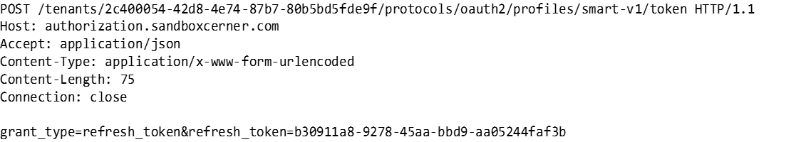
Example Refresh Token Request

Slide 50
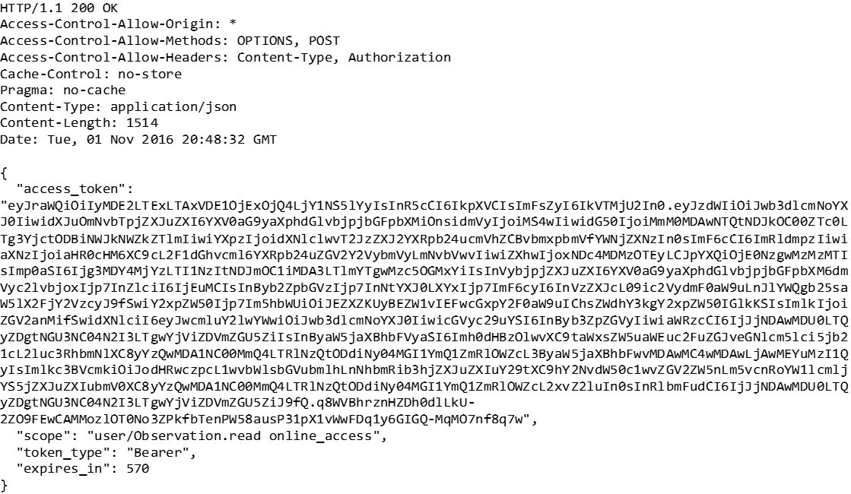
Example Refresh Token Response

Slide 51
Refresh Tokens
Refresh token responses may not contain the additional response parameters that were included in the original grant, such as the “patient” value seen during a launch.

Slide 52
Refresh Tokens
“offline_access” refresh tokens may require “client credentials” to utilize.
In Cerner’s ecosystem, Cerner Central system account credentials are required for use with such refresh tokens, sent via HTTP Basic authentication.

Slide 53
Refresh Tokens
Refresh tokens will continue to function until either:
The user’s session (“online_access”) is terminated or risk-based re-authentication is required (logging out, expiration, other security events).
The user or their administrator terminates the persistent grant (“offline_access”) via “manage authorizations”.
The organization terminates all access for your application to their FHIR® services.

Slide 54
System Access
Notes:
SECTION SLIDE: Right-click image to replace.
**Slide not built in master slides due to the ability to swap out images.

Slide 55
“System” Access
SMART® on FHIR® also describes a methodology for direct system-to-system security interactions.
For “system” actors, the “Client Credentials” flow is utilized. This is sometimes referred to as “B2B” or “Backend Services”.

Slide 56
“System” Access
“Client Credentials” Flow
+---------+ +---------------+
| | | |
| |>--(A)- Client Authentication --->| Authorization |
| Client | | Server |
| |<--(B)---- Access Token ---------<| |
| | | |
+---------+ +---------------+
Figure 6: Client Credentials Flow

Slide 57
“System” Access
Steps:
Discover the “token” endpoint via the FHIR® Conformance document.
Make a token request, including your client credentials.

Slide 58
“System” Access
Client credentials are sent using the HTTP Basic Authentication scheme.
For Cerner FHIR® services, credentials are issued via Cerner Central System Accounts.

Slide 59
“System” Access
Scopes for system access:
FHIR® scopes are prefixed with “system” to denote that access is on behalf of a system, not a user. They cannot be mixed with “user” or “patient” scopes.
You may request fewer scopes than your system is authorized to access – this is useful if you want to pass such tokens off to other components in your architecture that are “less trusted”.

Slide 60
“System” Access
Scopes for system access:
FHIR® scopes are prefixed with “system” to denote that access is on behalf of a system, not a user. They cannot be mixed with “user” or “patient” scopes.
You may request fewer scopes than your system is authorized to access – this is useful if you want to pass such tokens off to other components in your architecture that are “less trusted”.

Slide 61
“System Access”
Note: Few Cerner FHIR® services currently support direct access via client credentials grant. Refer to the documentation of the individual service.

Slide 62
Office Hours
Notes:
SECTION SLIDE: Right-click image to replace.
**Slide not built in master slides due to the ability to swap out images.

Slide 63
Office Hours
As our code learning lab is virtual this year, Cerner will be hosting office hours for any questions.
Friday November 11, 2020 @ 1:30pm

